Slide 1

Introduction to Machine Learning
Supervised Learning
By <Trainer’s Name>
<Date>

Slide 2
What is Classification?
<Topic>

Slide 3

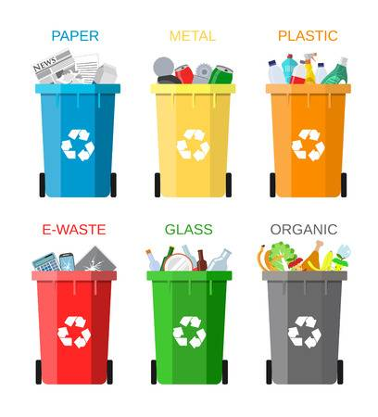
What is Classification?
“Classification is the process of grouping things according to similar features they share”
Paper
Metal
Plastic
E-waste
Glass
Organic
Notes:
The first question that arise in our mind is why Statistics?
Let me make you clear that Statistics is one of the key fundamental skills required for data science. Moving forward in the data science, if you go for any kind of algorithms then primarily knowledge in statistics is quite important. Actually, the statistics and probability are considered as the base knowledge and they are very essential for moving into any machine learning algorithms.

Slide 4
Types of Classification
<Topic>

Slide 5
Types of Classification
Logistic Regression
1
2
Decision Tree
Random Forest
3
4
K- Nearest Neighbour
Naïve Bayes
5

Slide 6
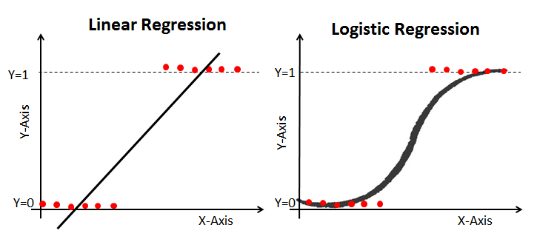
Types of regression
There are a lot of different regression types, but the most commonly used regressions in Data Science are:
Linear Regression
Logistic Regression

Slide 7
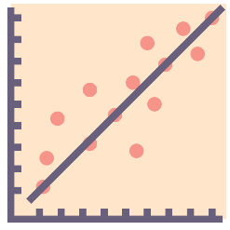


Types of regression
Linear Regression
Logistic Regression
Continuous Variables
Solves regression problems
The output would be a straight line
Categorical Variables
Solves classification problems
The output would be a S-curve

Slide 8
Logistic Regression
<Topic>

Slide 9
Logistic Regression
Classification Problems
Logistic Regression comes into the picture
Linear Regression cannot answer

Slide 10
Logistic Regression
Regression
Linear Regression
Supervised
Machine Learning
Logistic Regression
Classification
SVM
Unsupervised

Slide 11
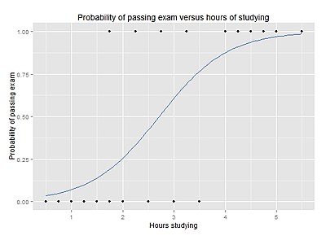
Logistic Regression
What is Logistic Regression?
A statistical classification model
Deals with categorical dependent variables
Could be binary or dichotomous
Could be multinomial
Takes both continuous and discrete input data

Slide 12

Logistic Regression
Why Logistic Regression?
Tool for applied statistics and discrete data analysis, gives outcome in terms of probability and in-turn helps in classifying the given data.

Slide 13
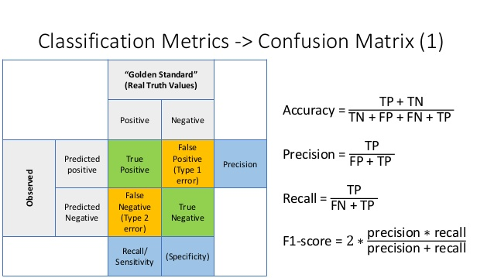

Slide 14
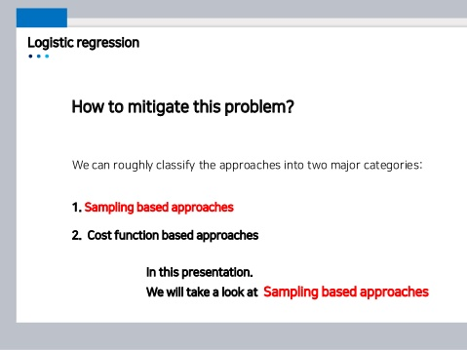

Slide 15
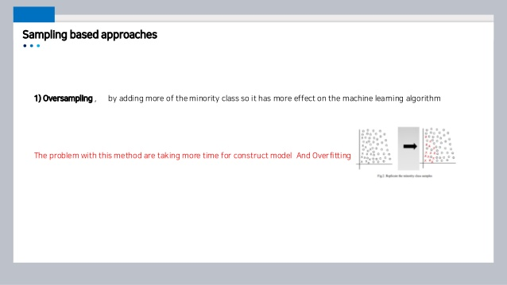

Slide 16
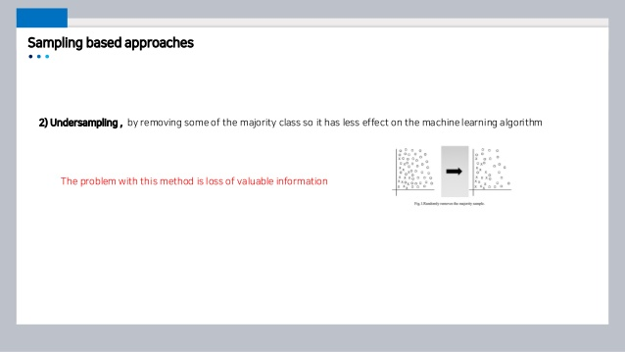

Slide 17
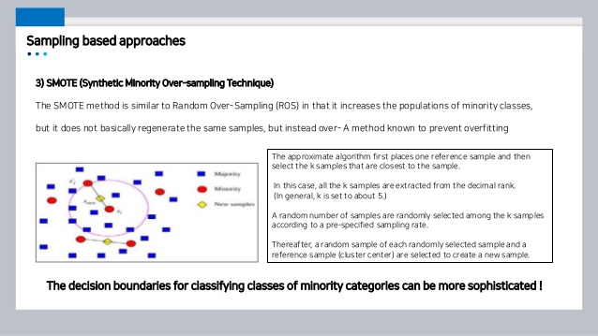

Slide 18


Thank You

